Slide 1
Human Activity Recognition

Slide 2
Data Collection
11 persons – including myself (6 males, 5 females, 19-24 years old)
Collected Data Summary:
15 activities / person
TOTAL: 539 mins
Name | Duration | Name | Duration | Name | Duration
Edwin | 89 | Elmo | 45 | Orlin | 45
Shelina | 45 | Monica | 45
Mellita | 45 | Inge | 45
Nikolas | 45 | Andri | 45
Samuel | 45 | Arianto | 45

Slide 3
KFOLD 11 Persons Results

Slide 4
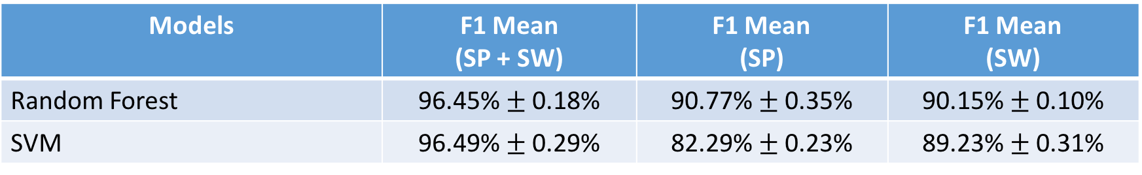
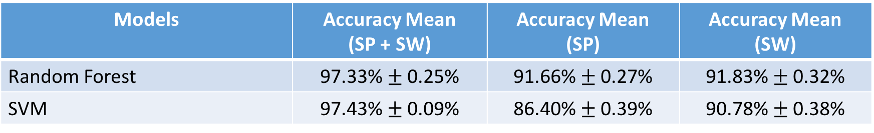
5-Fold CV on Combined Dataset (11 persons)
14 activities (WITHOUT EATING), Sampling @ 10 Hz, Window size = 2s
Comparison → 14 activities (WITHOUT EATING), 6 Persons results:
Models | F1 Mean (SP + SW) | F1 Mean (SP) | F1 Mean (SW)
Random Forest | 96.45% $±$ 0.18% | 90.77% $±$ 0.35% | 90.15% $±$ 0.10%
SVM | 96.49% $±$ 0.29% | 82.29% $±$ 0.23% | 89.23% $±$ 0.31%
Models | Accuracy Mean (SP + SW) | Accuracy Mean (SP) | Accuracy Mean (SW)
Random Forest | 97.33% $±$ 0.25% | 91.66% $±$ 0.27% | 91.83% $±$ 0.32%
SVM | 97.43% $±$ 0.09% | 86.40% $±$ 0.39% | 90.78% $±$ 0.38%

Slide 5

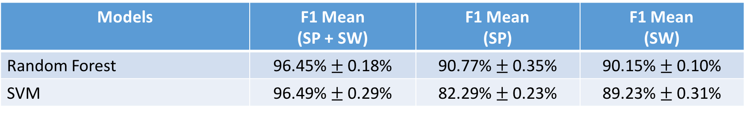
5-Fold CV (11 persons) – CORRELATION ACC_MAG
14 activities (WITHOUT EATING), Sampling @ 10 Hz, Window size = 2s
Comparison → 14 activities (WITHOUT EATING), 11 Persons results:
Models | F1 Mean (SP + SW) | F1 Mean (SP) | F1 Mean (SW)
Random Forest | 96.45% $±$ 0.22% | 90.45% $±$ 0.27% | 90.12% $±$ 0.33%
SVM | 96.32% $±$ 0.17% | 81.82% $±$ 0.47% | 89.03% $±$ 0.48%
Models | F1 Mean (SP + SW) | F1 Mean (SP) | F1 Mean (SW)
Random Forest | 96.45% $±$ 0.18% | 90.77% $±$ 0.35% | 90.15% $±$ 0.10%
SVM | 96.49% $±$ 0.29% | 82.29% $±$ 0.23% | 89.23% $±$ 0.31%

Slide 6
LOO 11 PERSONS (NEW)

Slide 7
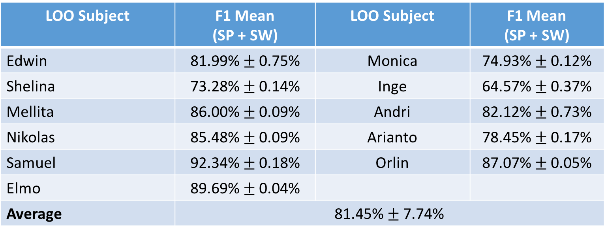
LOO (11 PERSONS)
14 Activities (without Eating)
RF→ Number of Estimators = 500, average of 3 runs / subject
LOO Subject | F1 Mean (SP + SW) | LOO Subject | F1 Mean (SP + SW)
Edwin | 81.99% $±$ 0.75% | Monica | 74.93% $±$ 0.12%
Shelina | 73.28% $±$ 0.14% | Inge | 64.57% $±$ 0.37%
Mellita | 86.00% $±$ 0.09% | Andri | 82.12% $±$ 0.73%
Nikolas | 85.48% $±$ 0.09% | Arianto | 78.45% $±$ 0.17%
Samuel | 92.34% $±$ 0.18% | Orlin | 87.07% $±$ 0.05%
Elmo | 89.69% $±$ 0.04%
Average | 81.45% $±$ 7.74%

Slide 8
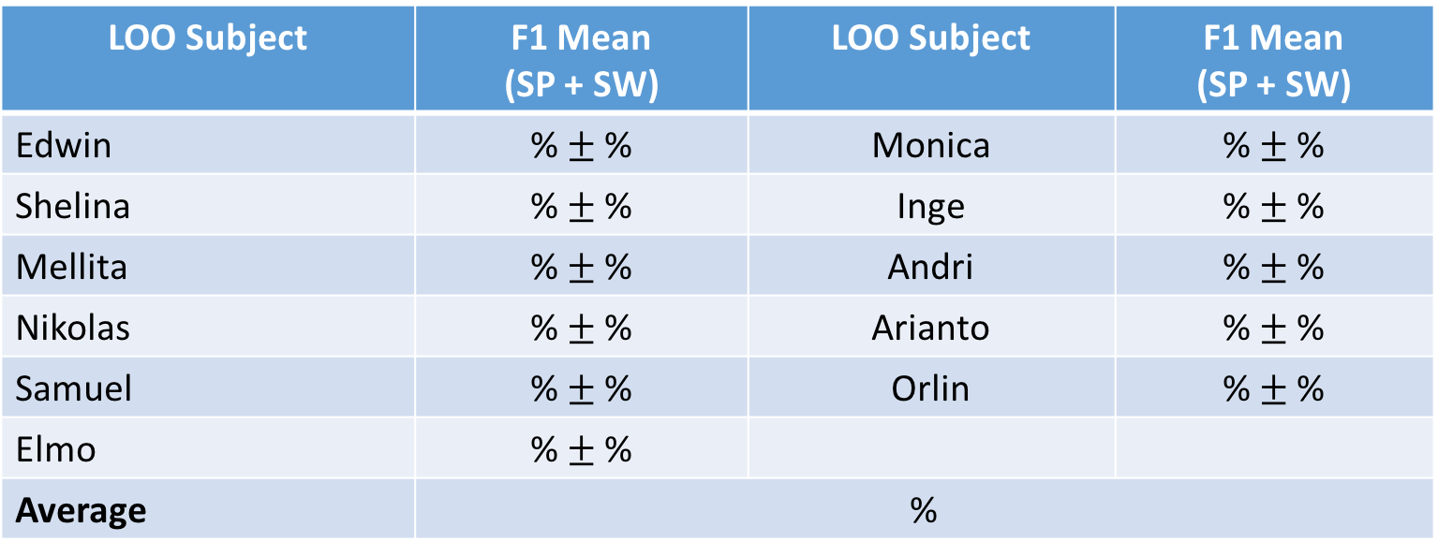
LOO (11 PERSONS)
14 Activities (without Eating)
SVM → C = 1, Gamma = 0.1
LOO Subject | F1 Mean (SP + SW) | LOO Subject | F1 Mean (SP + SW)
Edwin | % $±$ % | Monica | % $±$ %
Shelina | % $±$ % | Inge | % $±$ %
Mellita | % $±$ % | Andri | % $±$ %
Nikolas | % $±$ % | Arianto | % $±$ %
Samuel | % $±$ % | Orlin | % $±$ %
Elmo | % $±$ %
Average | %

Slide 9
LOO 11 PERSONS (CORR)

Slide 10
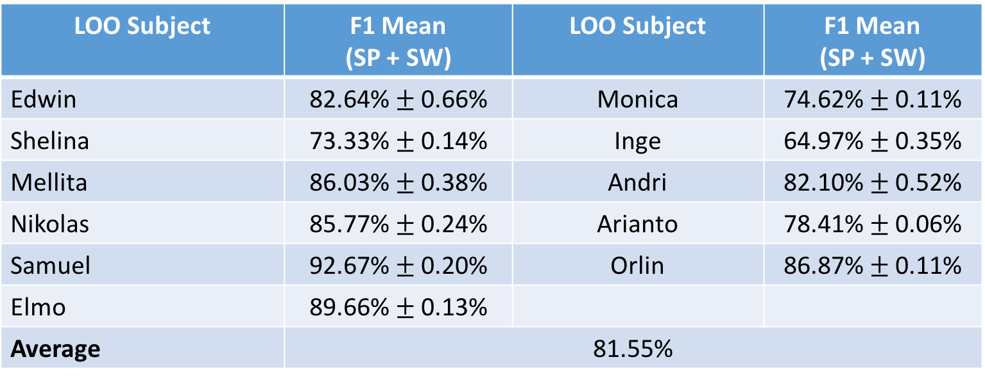
LOO (11 PERSONS)
14 Activities (without Eating)
RF→ Number of Estimators = 500
LOO Subject | F1 Mean (SP + SW) | LOO Subject | F1 Mean (SP + SW)
Edwin | 82.64% $±$ 0.66% | Monica | 74.62% $±$ 0.11%
Shelina | 73.33% $±$ 0.14% | Inge | 64.97% $±$ 0.35%
Mellita | 86.03% $±$ 0.38% | Andri | 82.10% $±$ 0.52%
Nikolas | 85.77% $±$ 0.24% | Arianto | 78.41% $±$ 0.06%
Samuel | 92.67% $±$ 0.20% | Orlin | 86.87% $±$ 0.11%
Elmo | 89.66% $±$ 0.13%
Average | 81.55%

Slide 11
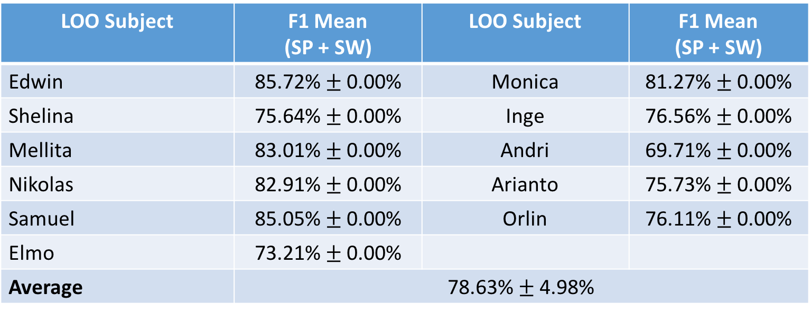
LOO (11 PERSONS)
14 Activities (without Eating)
SVM → C = 1, Gamma = 0.1
LOO Subject | F1 Mean (SP + SW) | LOO Subject | F1 Mean (SP + SW)
Edwin | 85.72% $±$ 0.00% | Monica | 81.27% $±$ 0.00%
Shelina | 75.64% $±$ 0.00% | Inge | 76.56% $±$ 0.00%
Mellita | 83.01% $±$ 0.00% | Andri | 69.71% $±$ 0.00%
Nikolas | 82.91% $±$ 0.00% | Arianto | 75.73% $±$ 0.00%
Samuel | 85.05% $±$ 0.00% | Orlin | 76.11% $±$ 0.00%
Elmo | 73.21% $±$ 0.00%
Average | 78.63% $±$ 4.98%

Slide 12
What’s next?
CSP?
Not sure how it works and how it can be applied since most applications are in the area of EEG → try 0-mean everything per subject
Different features?
Should we reduce the target number of subjects to 15 persons?
Only then, we can really find out which features improve the results
Try including barometer → may help in differentiating running, walking, going downstairs/upstairs
Try including gyrometer → to compare with barometer results
Implementing the smoothing in the real time application
Interim report

